Slide 2
What is Microservises
Why microservice coming to picture
what is monolithic architecture
Reasons for Using Microservice
Advantages of Microservices
Disadvantages of Microservices

Slide 3
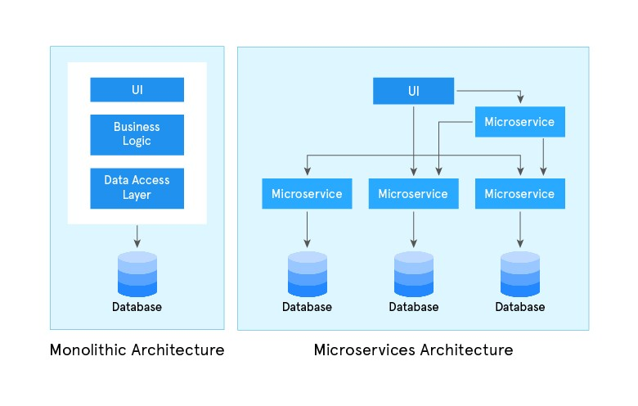
Monolithic Architecture & Microservice Arc

Slide 4
Why microservice coming to picture and what is monolithic architecture
In a monolithic application, everything is interconnected. This structure presents several challenges:
Complexity: Large applications are difficult to understand and manage.
Testing: Extensive manual testing is required to ensure changes don’t break the application.
Common Database: A single database supports the entire application, creating bottlenecks.
Deployment: Even small changes require redeploying the whole application.
Startup Time: Large applications can be slow to start up.

Slide 5
Reasons for Using Microservice
In monolithic applications, there are a few challenges:
For a large application, it is difficult to understand the complexity and make code changes fast and correctly, sometimes it becomes hard to manage the code
Applications need extensive manual testing to ensure the impact of changes
An application typically shares a common relational database to support the whole application
For small changes, the whole application needs to be built and deployed
The heavy application slows down start-up time

Slide 6
Advantages of Microservices
Scalability: Scale individual components to handle high traffic and adapt to demands.
Flexibility and Agility: Enable independent development, deployment, and updates for faster
iteration and continuous delivery.
Fault Isolation: Operate independently, ensuring system stability and resilience despite failures.
Technology Diversity: Utilize different technologies for each service, fostering innovation.
Scalable Development: Teams work independently on specific services, enhancing productivity and
speeding up time-to-market.

Slide 7
Disadvantages of Microservices:
Complexity: More complex than monolithic systems, making development, testing, and debugging harder.
Operational Effort: Requires extra effort to manage and maintain multiple services.
Network Delay: Communication between services can introduce delays, impacting performance.
Data Consistency: Challenging to maintain consistent data across decentralized storage.
Distributed System Challenges: Issue

